Slide 1
Visualizing The Public Health Narratives Around Covid-19
Team Members
Avinash Pawar
Ashish Patidar
Shardul Samdurkar
Tanay Kulkarni
Notes:
Hi guys Im Avinash Pawar. Today im presenting our Project Plans for the ----subject my team members are ----

Slide 2
Analysis of Media Coverage on Common COVID-19 Glossary
What are we working on?
Notes:
We are trying to analyze the total media coverage on common covid 19 glossaries.
for the scope this project, we have chosen 10 most covid 19 related words, such as vaccine, quarantine, death rate, varients etc.

Slide 3
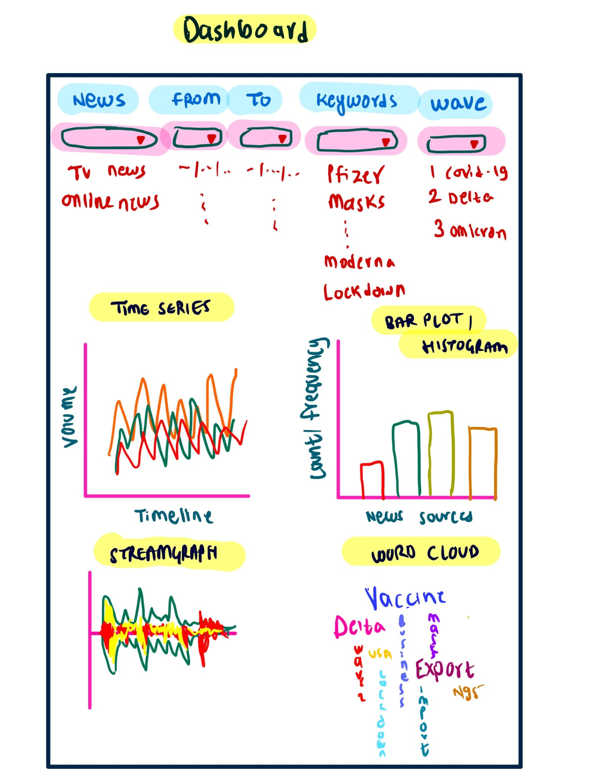
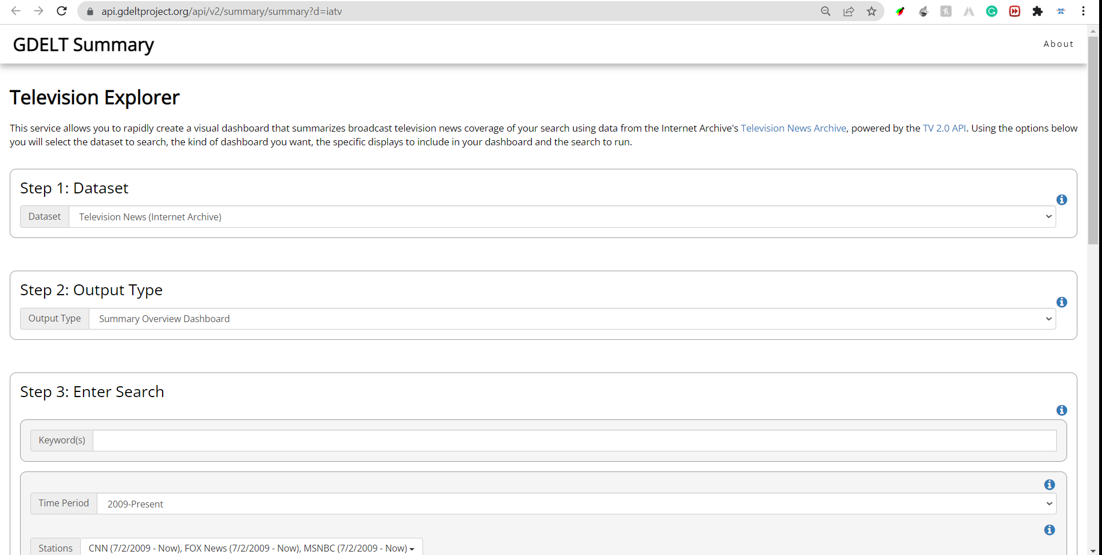
Where did we start
Dataset
Initial Sketch
Notes:
for this project, a lot of public datasets are available, but we have chosen the, GDELT project Dataset, which is recommended by our client. It is a Global Database of Events, Language, and Tone
GDELT monitors, the world news media, in all formats such as print, broadcast, and web , they have coverage in over 100 languages.
Also the dataset is, available to download in RAW format, as well as the project has their own API to query on the Dataset.
For visualization we have decided to go with a dashboard where you can see various comparative graphs of comannly used covid-19 related words

Slide 4
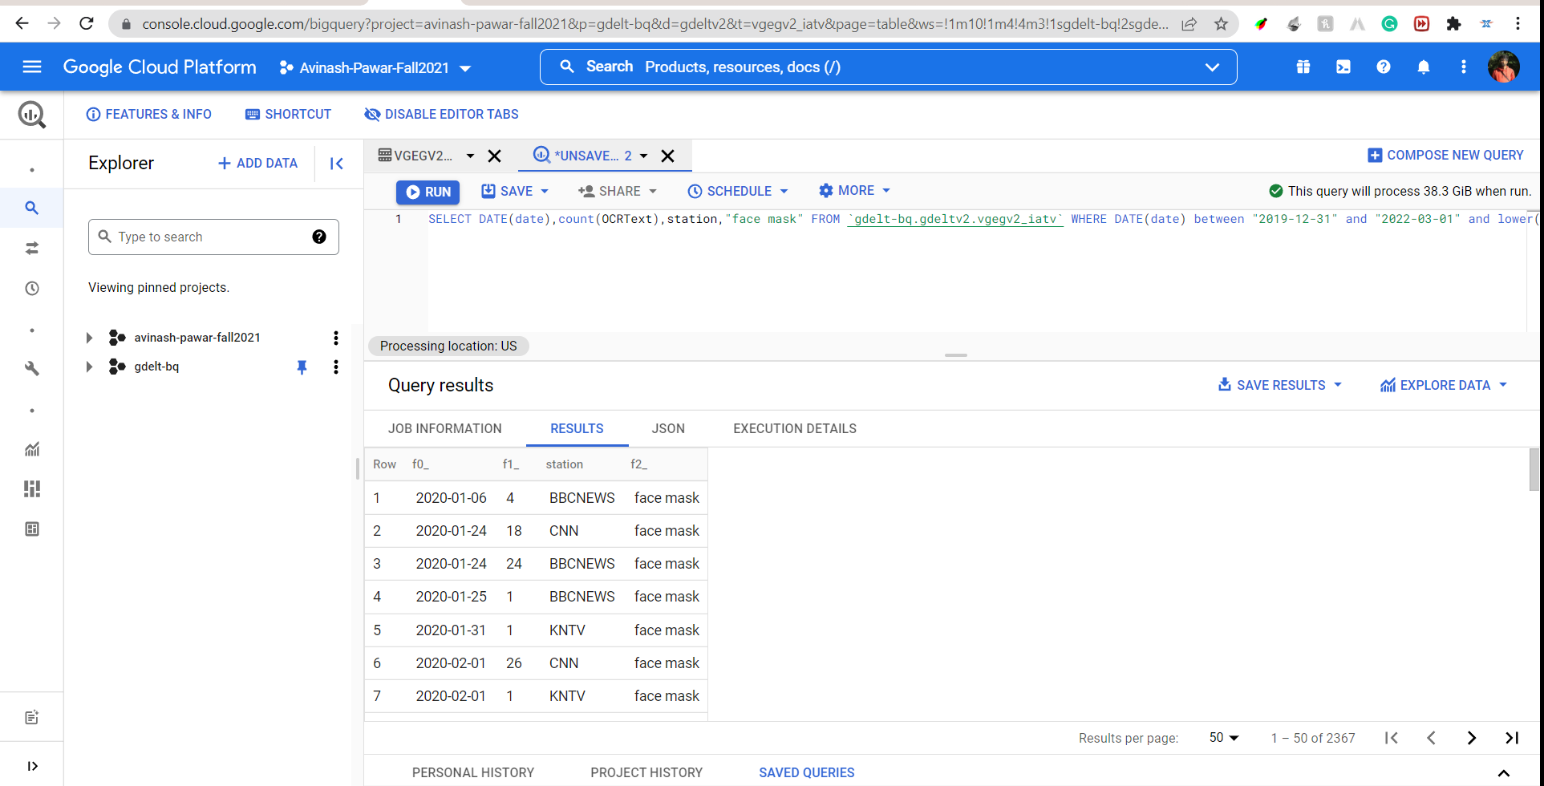
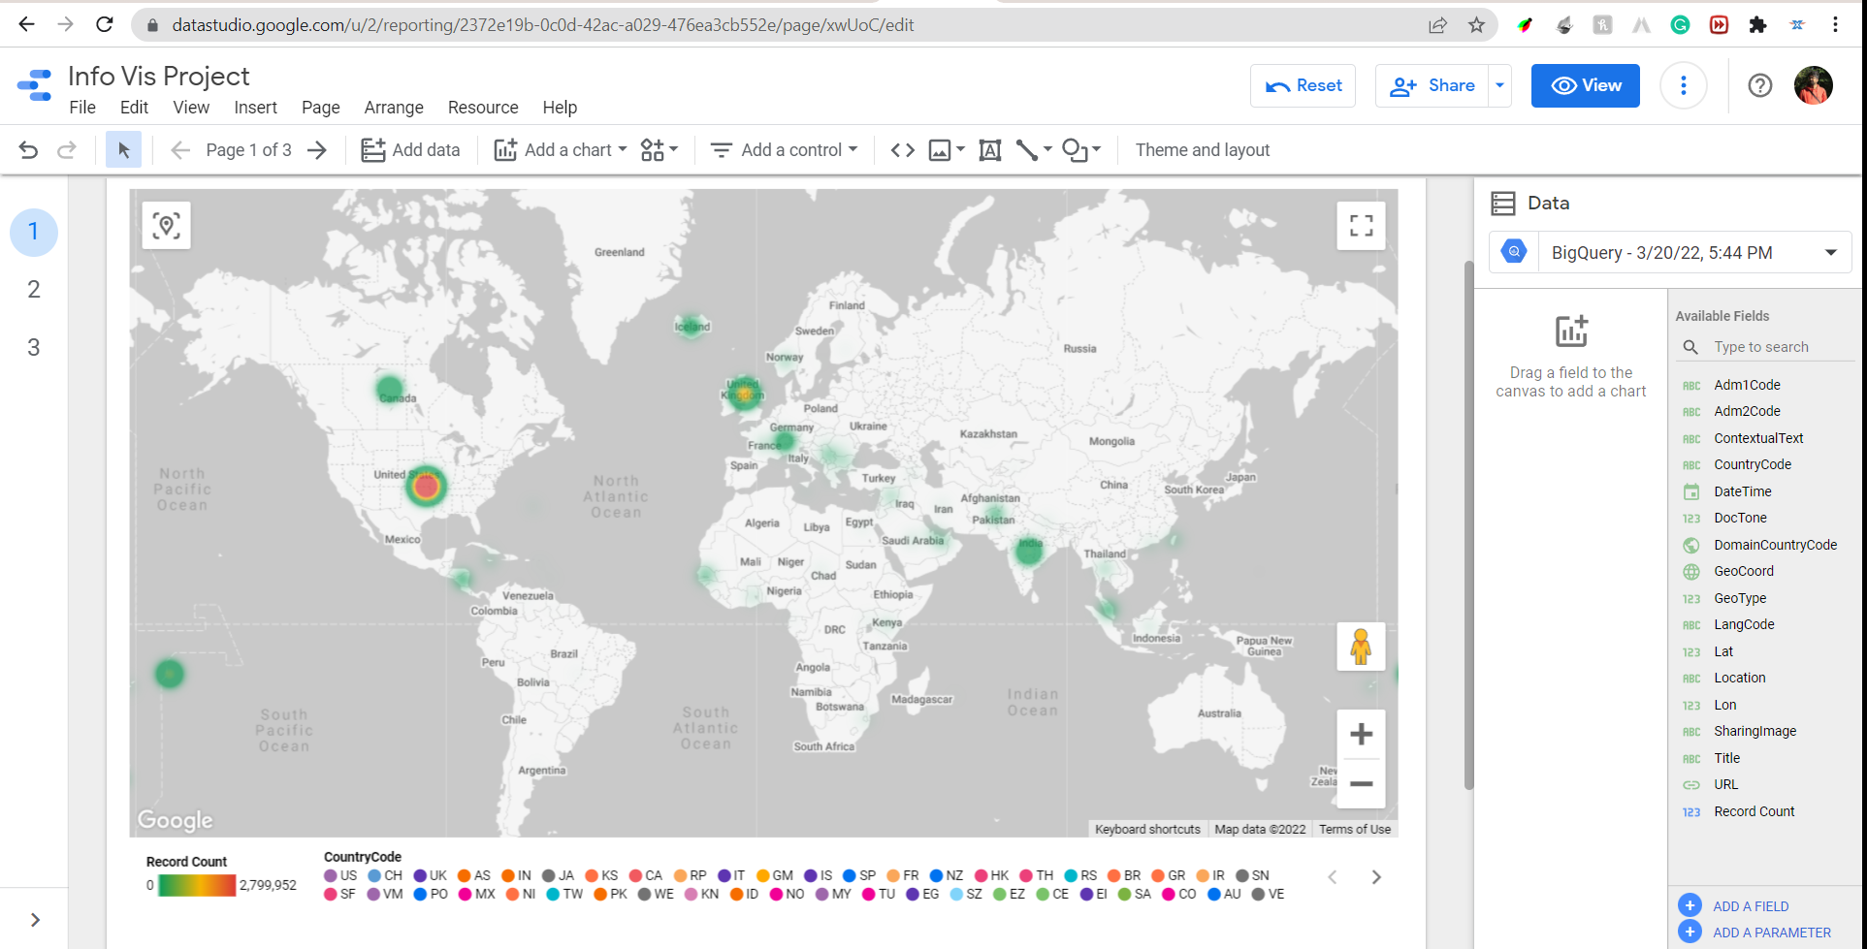
Pre-Analysis
Google Big Query
Google Data Studio
Notes:
As the dataset is abut 200 Giga bytes the processing of the database is canont be done on a single computer hence we have chosen the google Big qury platform for doing the analysis of data Also just querying the data has no use for us we also have used google Data studio for visualizing the data as it is very easy to integrate that with Google big query platform

Slide 5
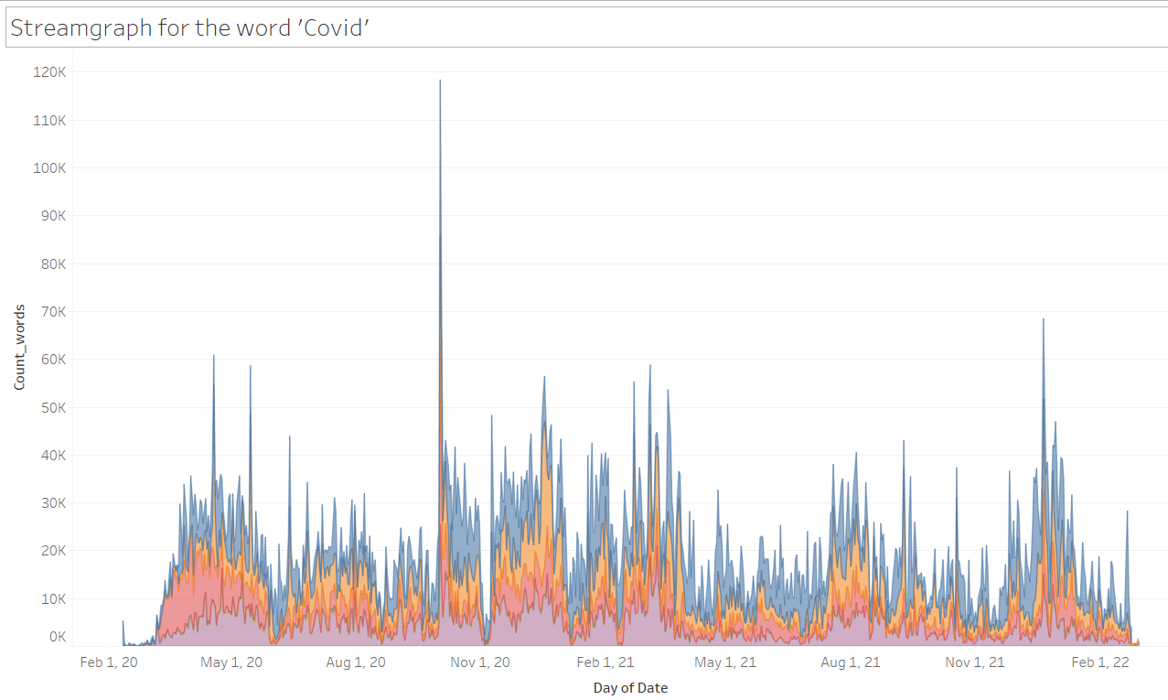
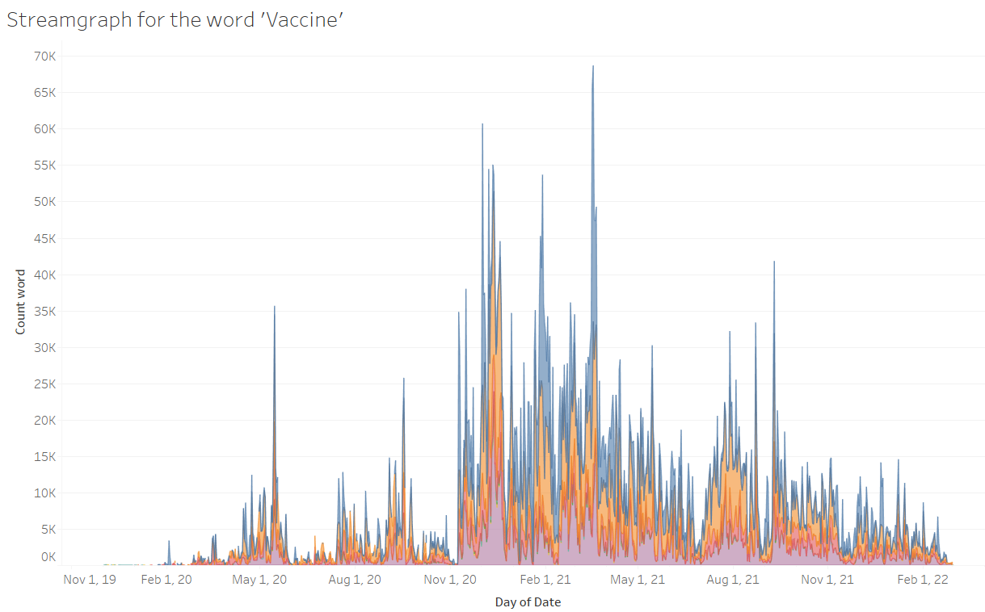
Visualizations - Temporal Analysis
Stream Graph
What we found
The Stream graph provided us with useful information. The streamgraph for the term 'Covid' demonstrated how its usage evolved over time when covid waves came. The streamgraph of the term 'Omicron' demonstrated how its use rose during the third wave. The streamgraph for the term 'Vaccination' illustrates how frequently it has been used since the earliest vaccine trials, indicating a favorable feeling.We gained good insights from the Stream graph. The streamgraph for the word ‘Covid’ showed that how it’s usage changed over time as and when the covid waves arrived. The streamgraph of the word ‘Omicron’ showed how its usage increased during the 3rd wave. The streamgraph for the word ‘Vaccine’ shows how frequently it was used since the trial of the first vaccines and hence representing a positive sentiment.

Slide 6
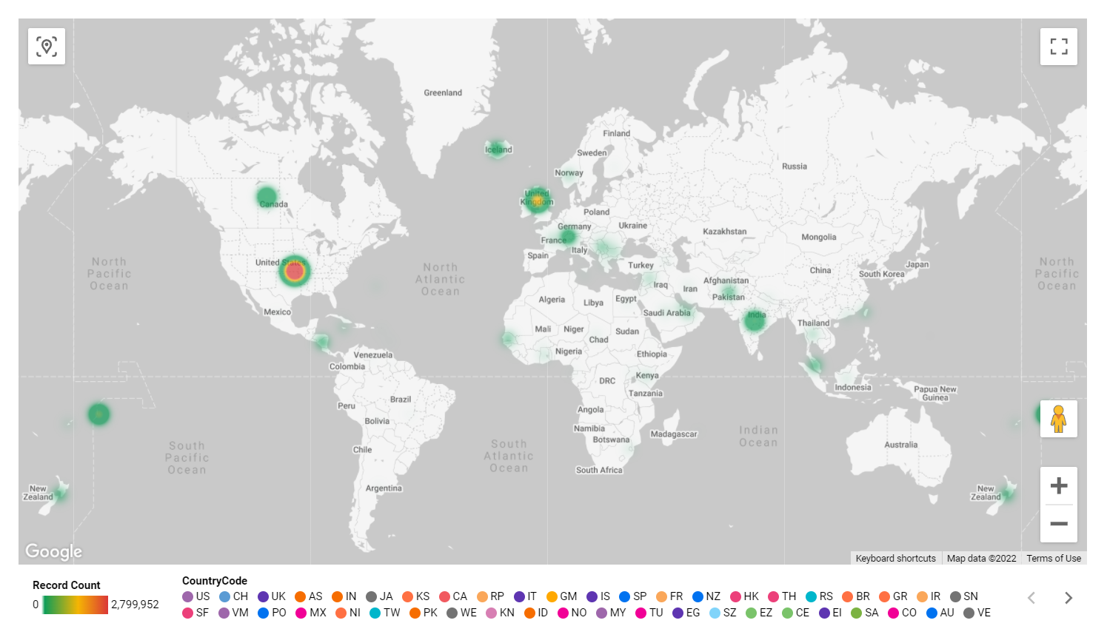
Geospatial Analysis
Geospatial Graph
What we found
According to a globe heat map generated using our data, the United States has the largest number of online news stories or debates for covid19, followed by the United Kingdom and Canada. India and American Samoa have about similar numbers of articles for them. The rest of the world's countries have little or no web news about covid.

Slide 7
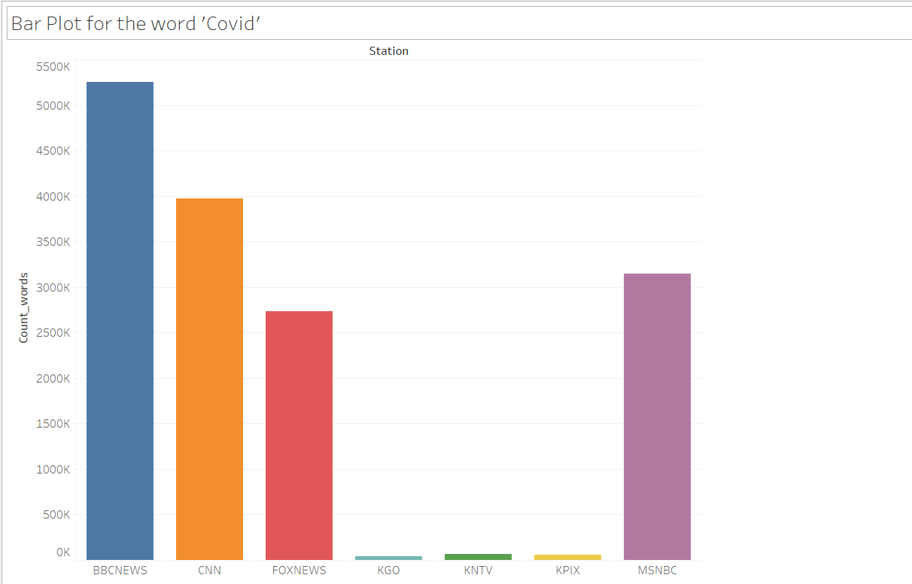
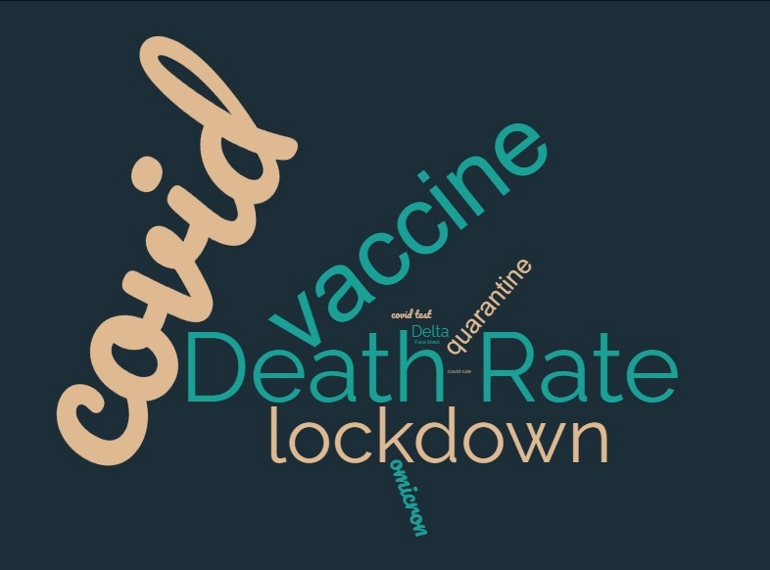
Topical Analysis
Bar Graph
&
Word Cloud
What we found
The bar plot shows how frequently different news stations or channels used a particular word during the covid pandemic. From these plots we can infer that the channels BBC and CNN have the more frequency of words which shows their viewers are comparatively greater than others.
We can see from the word cloud that the highest weighted terms are Death Rate and Covid. Vaccine and lockout are the next most weighted terms, while Face Mask, Covid Test, and Delta are the least weighted. As a consequence, we can state that Death Rate and Covid are the most often used terms used in news media when compared to other words.

Slide 8
What Next?
For our future work we would like to have More vizualisations of simmilar related Covid-19 related words.
We would also like to experiment with other alternative Databases and like to add More datasets if available.

